Slide 1


Cruz-Rabe Pharmacy
Request
System

Slide 2

Project Authors
Project Professor
Mr. Manuel Sebastian Sanchez
Project Consultant
Dr. Manuel Calimlim Mr. Alfredo Calimbo
Project Adviser
Mr. Jayvee Cabardo
Project Team
Carl Dominique Bueno Glen Roy Rosales

Slide 3
Client Information
Company/Organization Name | Project Name | Primary Contact Person
Cruz-Rabe Maternity & General Hospital | Cruz-Rabe Pharmacy Request System | Carmelita D. Buenaflor
Health Facility Detailed Information
ACCREDITATION NO: H92007290 PMCC NO: 313634 INSTITUTION NAME: Cruz-Rabe Maternity and General Hospital ROAD NAME: 37 Gen. Luna Street BARANGAY: Tuktukan MUNICIPALITY: Taguig City PROVINCE: Metro Manila (SOUTH) REGION: NCR (SOUTH) CATEGORY: Level 2 CLASSIFICATION: Private

Slide 4
Project Context
In order to ensure patient's safety, cost effective processes and well managed admission on managing medical services, preventing clinical errors and use resources efficiently, business process should have a sufficient tool which is automation of “pharmacy request system.” Transactions that are processed in different factors including; IN and OUT patient order entry, dispensing orders, pharmacy inventory and purchasing management will stand-alone by providing innovative way of service. Our client Cruz-Rabe Maternity General Hospital combines with the latest technology enabling complete control to develop medical management and to bring satisfaction to their clients in terms of professional service.

Slide 5
Success Factors
We can assume that the system will be feasible if we meet the following requirements:
If the system seems to be helpful when hospital transactions
(pharmacy requests) are now processed in just a few moments.
Results produced are accurate and reliable for the patients.
Hospitals records can be track down easily from its database.
Less resources are produced but service will be doubled.
We can assume that the system will be successful for a long term if we meet the following requirements:
If the system are useful to patients and hospital staffs in exchange to service, performance and satisfaction.
If it will generate enough revenue to the maintenance of the system.

Slide 6
Business Risk
RI-1: Might take critics since the organization is not prioritizing the
pharmacy department regarding in its business transactions.
RI-2: It will require equipment and services in order to produce the
system. This means, the organization need to invest in this project
as there is a possibility to make changes in certain aspects such
as its maintenance and security.
RI-3: The client has three more branches, which implies that there will
be discussions about the implementation of the new system. On
what might be the outcome is unpredictable. Chances are it could
create huge impact in the organization’s workflow

Slide 7
Purpose and Success Factors
P1: Make the processing of prescriptions easier and faster by 100%
and above.
P2: Reduce the loss of data by 80% of the existing and upcoming
records.
P3: Increase efficiency of work in input of information and processing
of requests by the pharmacists for about 80% upon
implementation. S1: The pharmacists are able to maximize the use of the Pharmacy
Request System immediately after its release.
S2: Receive a positive feedback from the client regarding the increase
average amount of work done by the pharmacy department

Slide 8
General Objectives
Paperless Transactions System (PTS)
Automation of Pharmacy Request System
Hospital transactions are direct generated electronically or online.
Patients will be satisfied on automated storage of data and results.

Slide 9
Specific Objectives
Eliminate mistakes caused by manual steps and workarounds
Creating more efficient workflow processes
Prevent drug diversion
It saves resources and money.
Increased Data Availability.
Patients record are documented that can be requested anytime.
Pharmacy system will be more reliable and convenient.
Tracking medications throughout the hospital in real time.
Less tedious on data mining and documentation.
Hospital Integration and Innovation.
One of the system’s feature associated with service and performance.
Save and Track Relevant Information in real time.
Convenient way of discharging patients.
Enable hospitals on global scale and keep up on date.

Slide 10
Vision Statement
An online-database for processing pharmacy request within a system, dedicated to ease the way of accepting requests by pharmacists to process the automated prescription orders and dispensing of orders in a better way. It will not only verify the information received, but also keep the records in a secured database which can be accessed for future preferences. Unlike the old-way of manual processes, Cruz-Rabe Pharmacy Request System intended to improve the quality of work in the medical field by providing the essential steps of transactions in fast-pace. The vision of this system is determined to meet patients satisfaction in terms of service.

Slide 11
Scope and Limitations
Users System was intended for pharmacists to use in their service that assists patients’ drug requests that is prescribed by doctor. Alternatively, the Pharmacy Requests will be assumed to me automated and data will be on a database for data warehouse. This scheme will ease the work of the auditing staff and the discharging process of patients.
Assumptions and Dependencies
AS-1: Additional equipment, services, and maintenance, will be
improvised for the authorized personnel to do the business
processes. AS-2: The hospital will be developed to ensure the system was
implemented well. Lesser hardcopies, more softcopies for the
records. DE-1: If the pharmacy requests were send to other departments, for
reviews and approval to support the system for consistency.

Slide 12
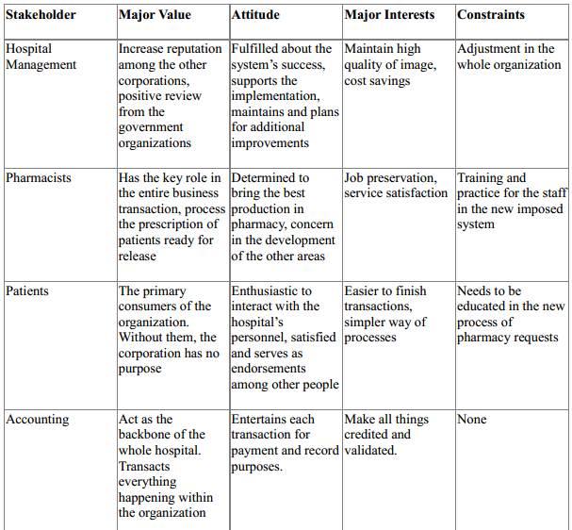
Human Resources Profile

Slide 13


Review of Related Literature

Slide 14
Technical Background
◌ Major Features:
F1: Process the doctor’s chart to process prescriptions online. F2: Input the pharmacy request slip form information in the
system. F3: Collects data from the stakeholders to be stored in the
secured database. F4: Access the records of patients anytime, anywhere within the
hospital branches. F5: Checks the validation and availability of the requests. F6: Secures the authorization of the pharmacists and authorized
personnel to do the process. F7: Process accounting transactions through an automated
manner. F8: Sends the information throughout the other departments
electronically.

Slide 15
The web site will contain following features
Detailed background information of the hospital and its history.
Keep patients up to date of hospitals news and announcements
Health tips for the visitors.
Online health related problem solving by the experts.
Health related news.
Online threads of health concerns with experts and their comments.
Mailing system for the users who are seeking information.

Slide 16

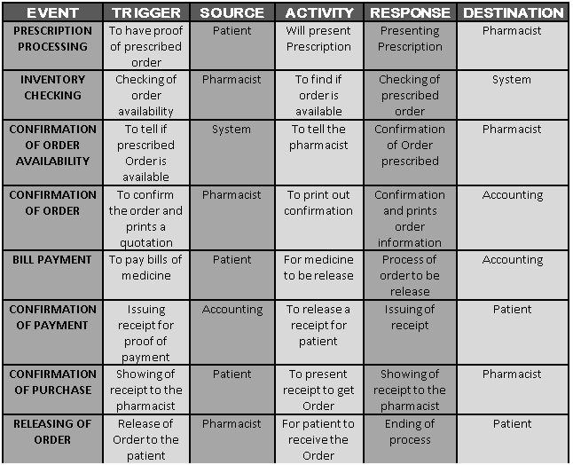
Event table

Slide 17
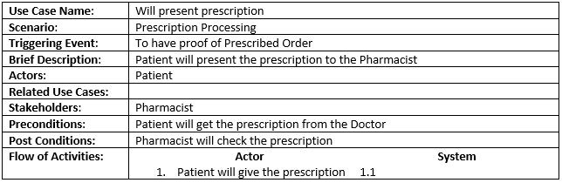
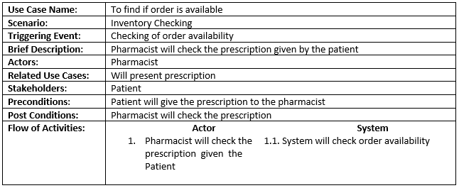
Use Case Full Definition

Slide 18
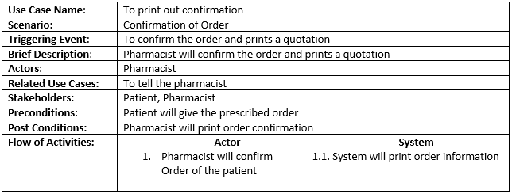
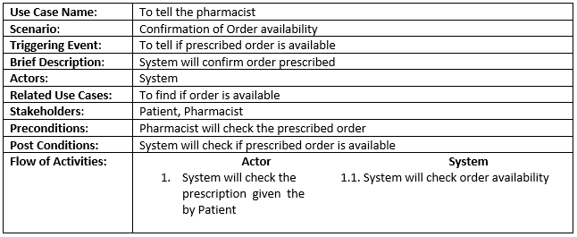

Slide 19
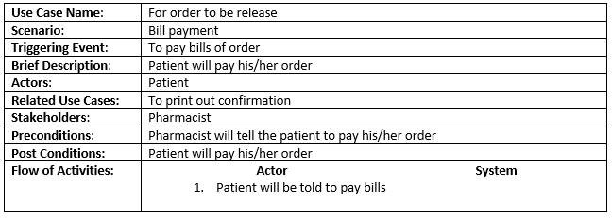
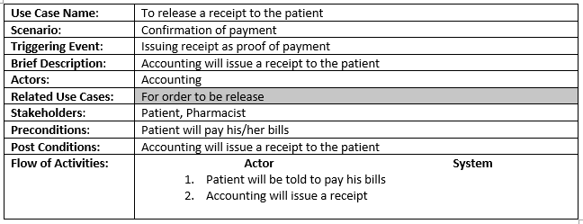

Slide 20
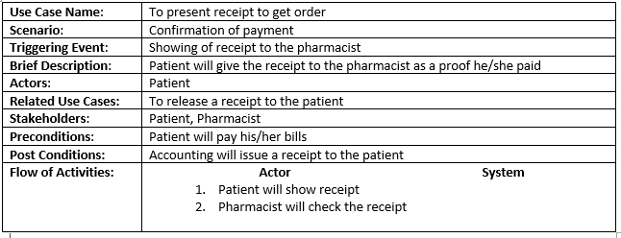
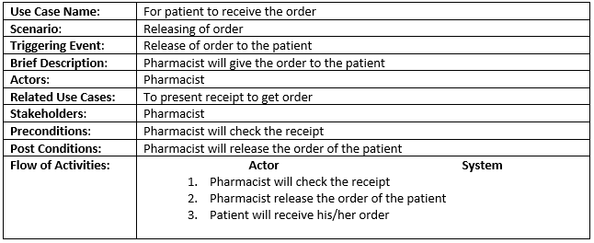

Slide 21
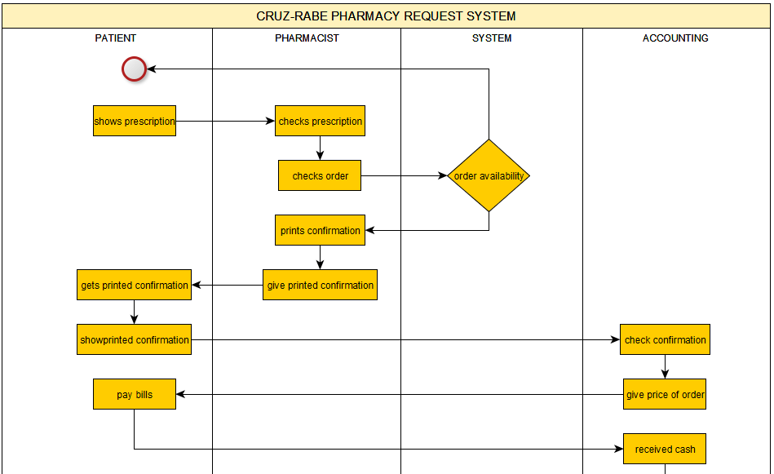
Activity Diagram

Slide 22
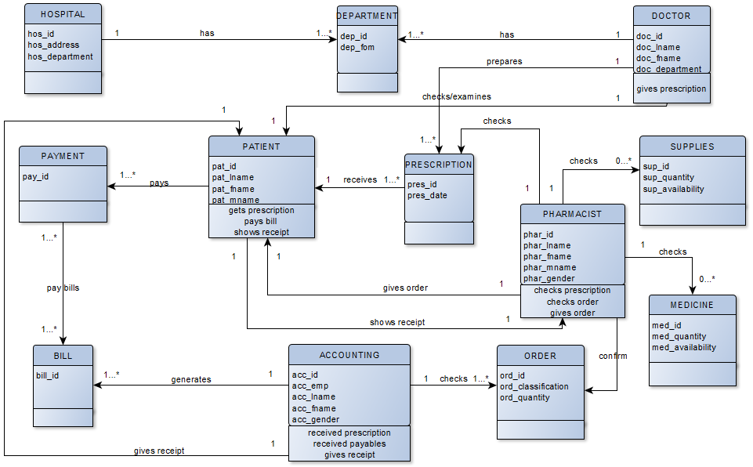
Class Diagram

Slide 23
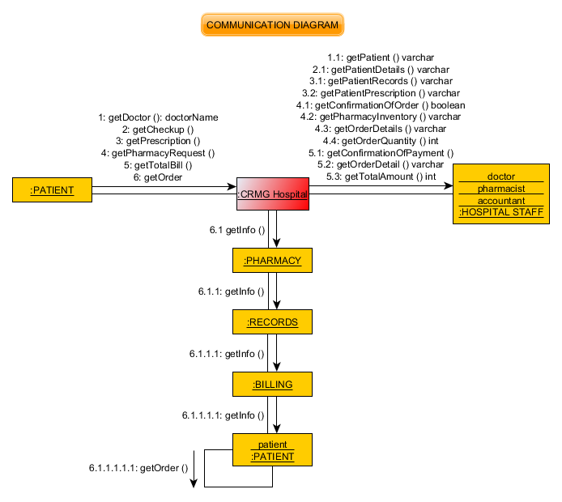
Communication Diagram

Slide 24
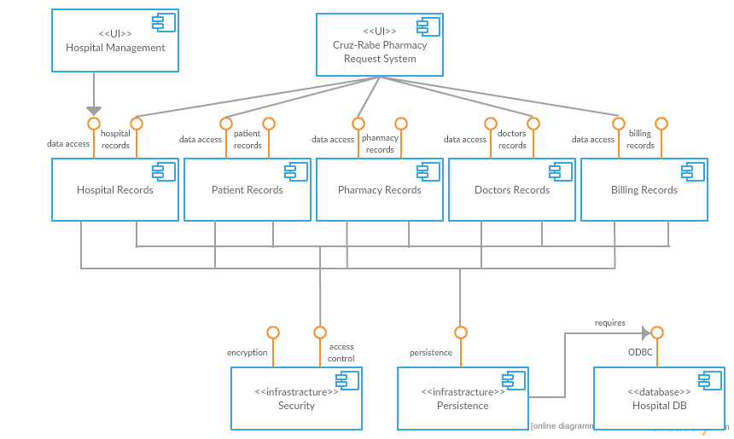
Component Diagram

Slide 25
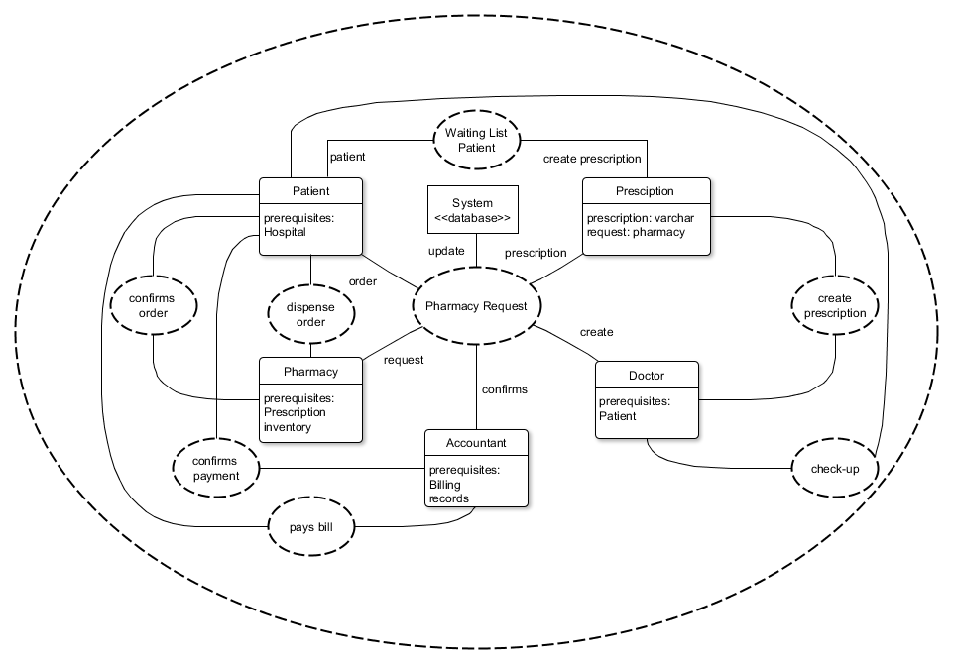
Composite Diagram

Slide 26
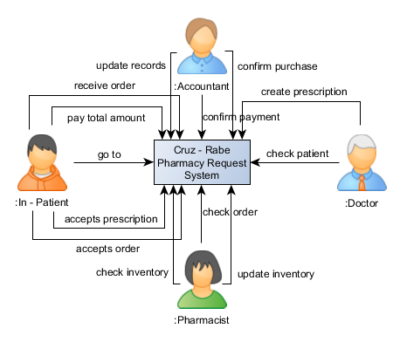
Context Flow Diagram
In - Patient

Slide 27
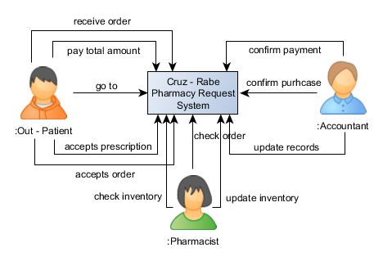
Context Flow Diagram
Out - Patient

Slide 28
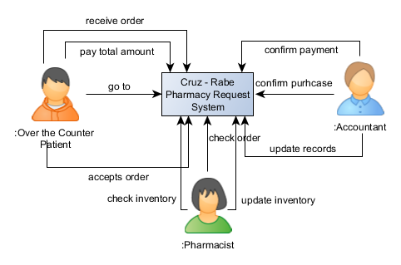
Context Flow Diagram
Over the Counter Patient

Slide 29
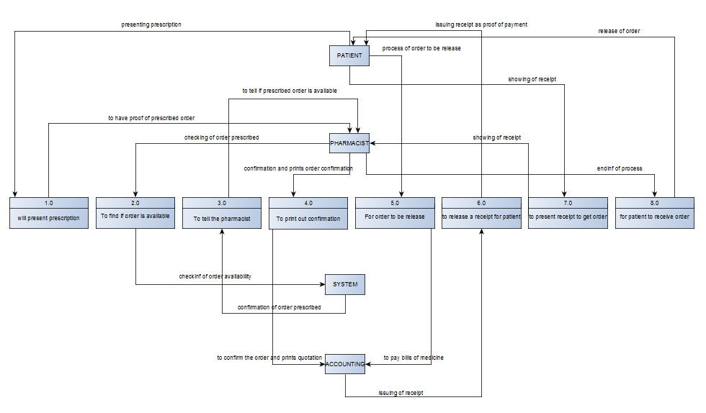
Data Flow Diagram

Slide 30
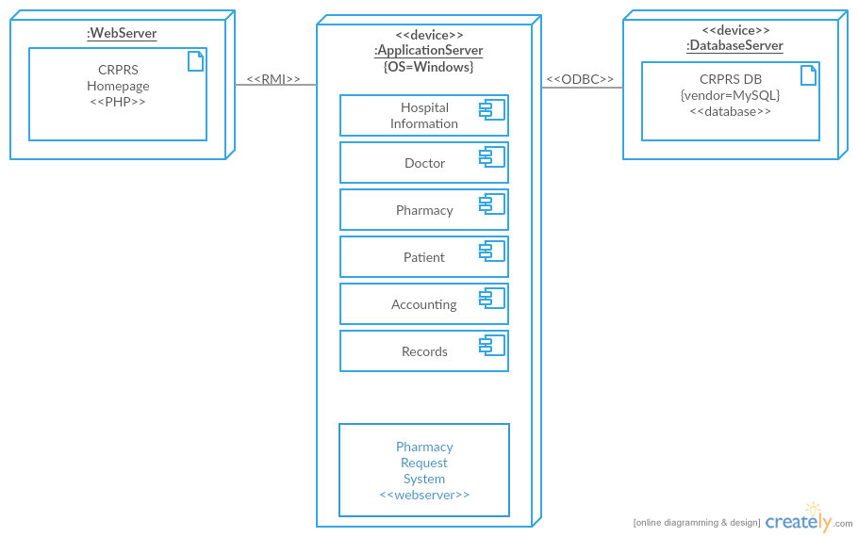
Deployment Diagram

Slide 31
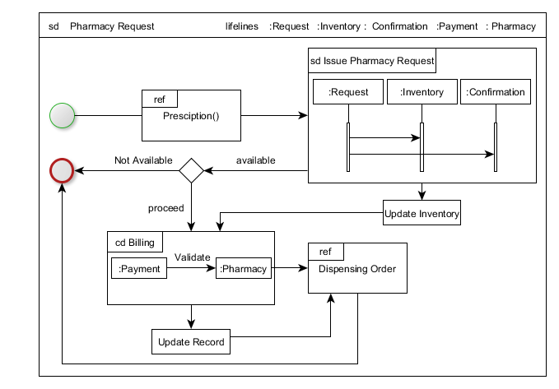
Interaction Overview Diagram

Slide 32
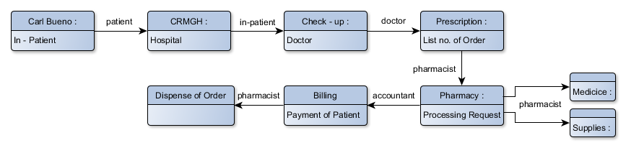
Object Diagram
In - Patient

Slide 33
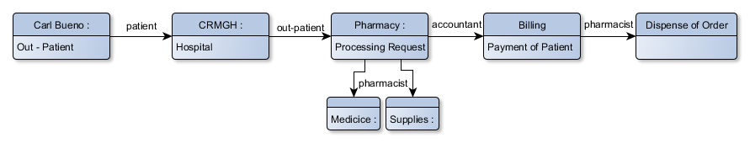
Object Diagram
Out - Patient

Slide 34
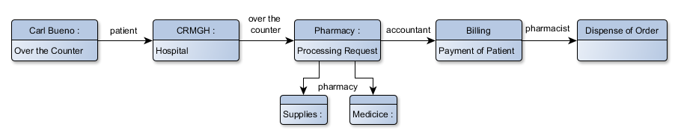
Object Diagram
Over the Counter Patient

Slide 35
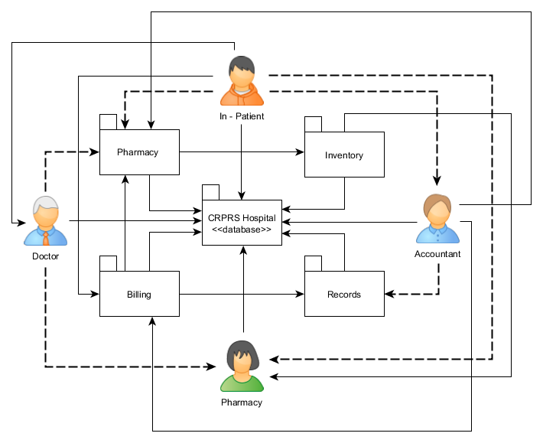
Package Diagram
In - Patient

Slide 36
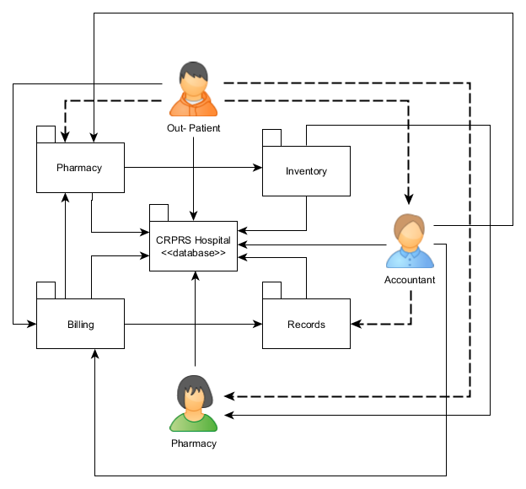
Package Diagram
Out - Patient

Slide 37

Package Diagram
Out - Patient

Slide 38
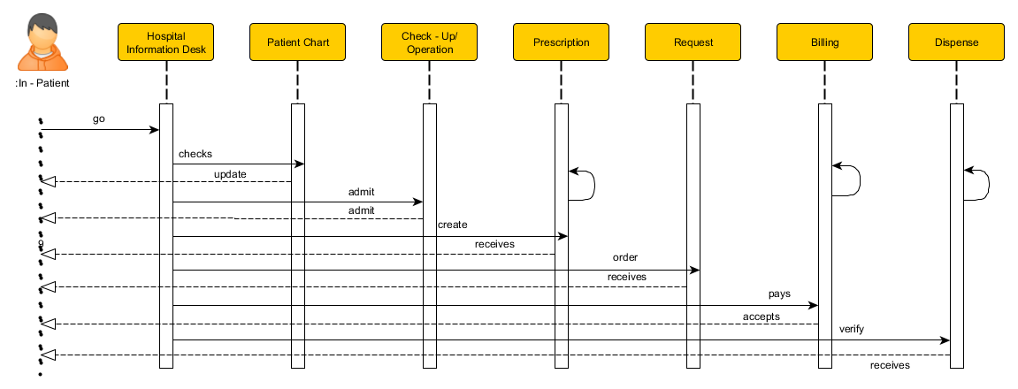
Sequence Diagram
In - Patient

Slide 39
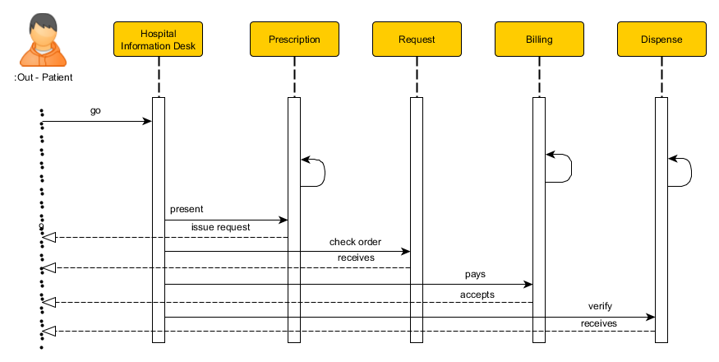
Sequence Diagram
Out - Patient

Slide 40
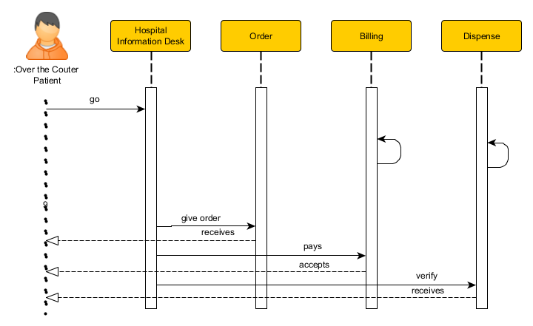
Sequence Diagram
Over the Counter Patient

Slide 41
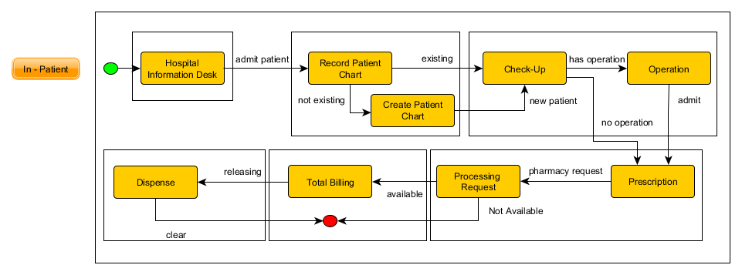
State Machine Diagram
In - Patient

Slide 42
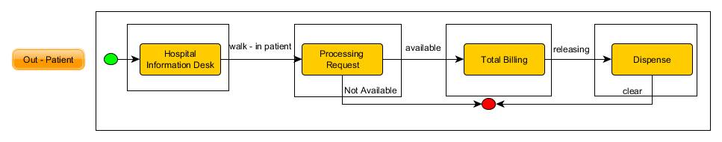
State Machine Diagram
Out - Patient

Slide 43
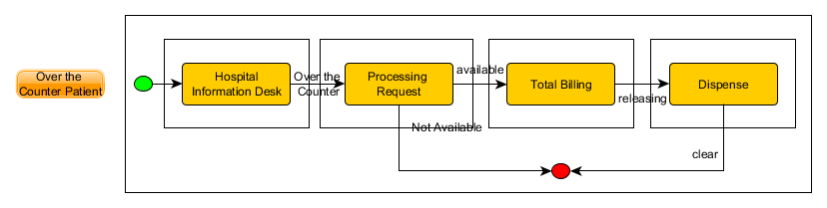
State Machine Diagram
Over the Counter Patient

Slide 44
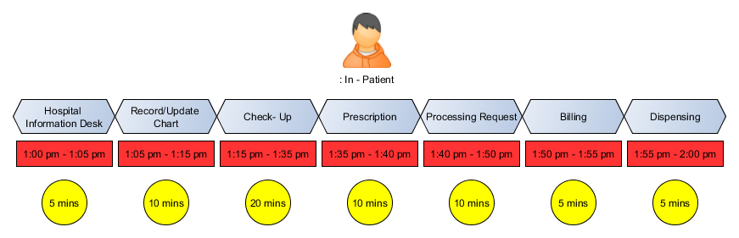
Timing Diagram
In- Patient

Slide 45
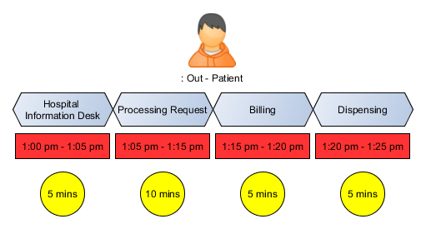
Timing Diagram
Out - Patient

Slide 46
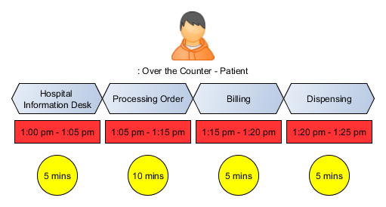
Timing Diagram
Out - Patient

Slide 47
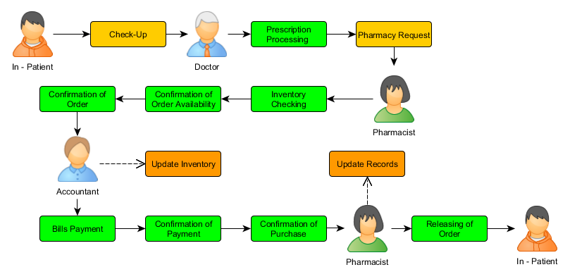
Use Case Diagram
In - Patient

Slide 48
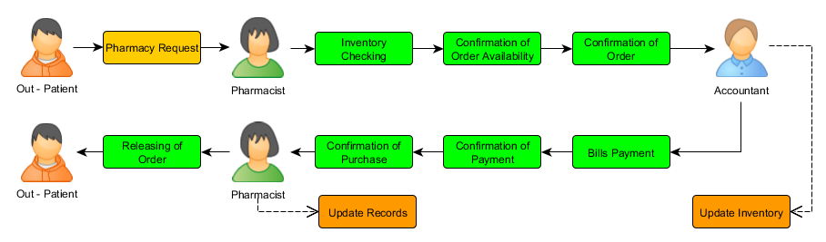
Use Case Diagram
Out - Patient

Slide 49
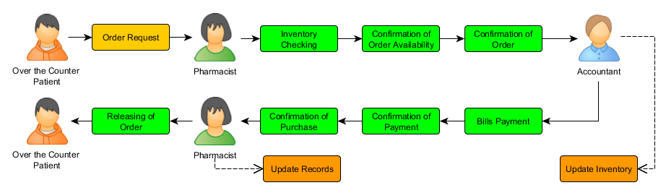
Use Case Diagram
Over the Counter Patient

Slide 50
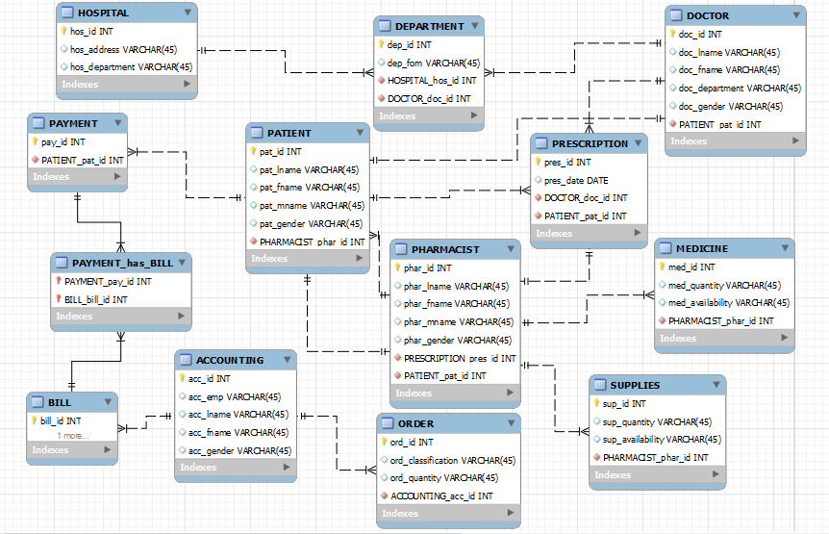
Entity-Relationship Diagram

Slide 51
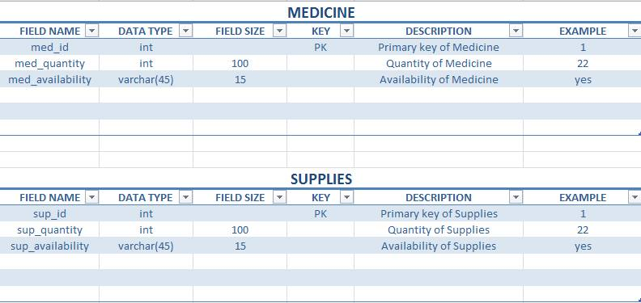
Data Dictionary

Slide 52
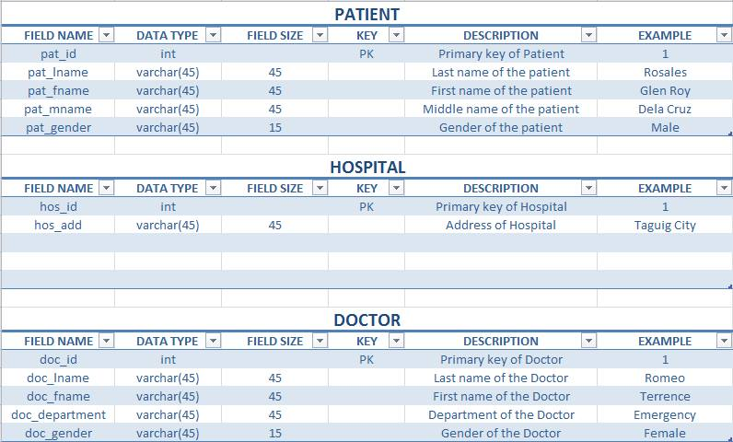
Data Dictionary

Slide 53
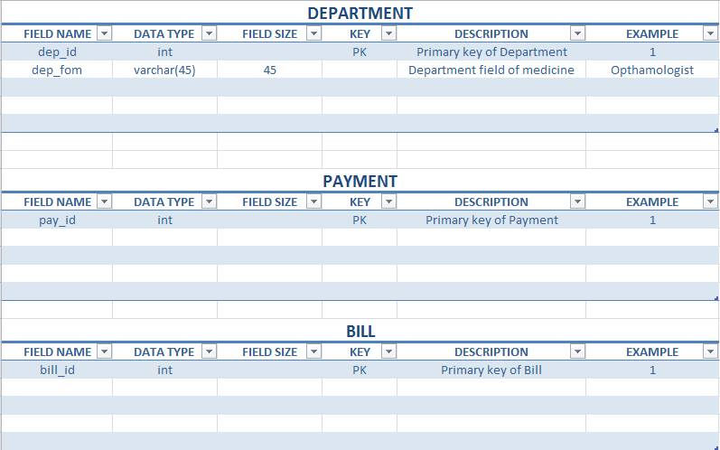
Data Dictionary

Slide 54
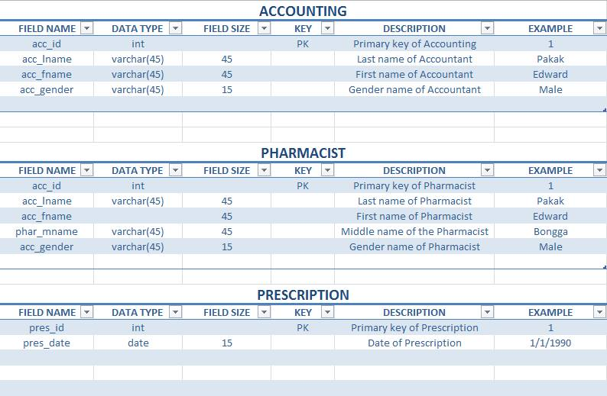
Data Dictionary

Slide 55
Reference/s:
http://projects2.apc.edu.ph/wiki/index.php/Project_-_Cruz-Rabe_Pharmacy_Request_System_%28CR-PRS%29_-106
http://moodle2.apc.edu.ph
http://www.omnicell.com/About_Omnicell.aspx
https://www.pioneerrx.com/web/pioneerrx

